Slide 1

Green Software
Green software refers to the development and operation of software with minimal environmental impact.
It focuses on reducing energy consumption, optimizing code for efficiency, and lowering carbon emissions.
This can involve using fewer computational resources, leveraging renewable energy, and creating sustainable development practices.

Slide 2
What is a Software Practitioner?
Software Practitioners
Software practitioners are professionals who work in the field of software development.
They include various roles such as software developers, programmers, software engineers, testers, system architects, and project managers.
Examples
Developers, testers, product managers, operations engineers, and data scientists.

Slide 3
What is a Green Software Practitioner?
Green Software Practitioner
A Green Software Practitioner is a professional focused on developing and maintaining software in an environmentally sustainable way. They aim to reduce the energy consumption, carbon footprint, and overall environmental impact of software.
Key Goal
To create software that is efficient, sustainable, and minimizes carbon emissions.

Slide 4

Key Areas of Focus: Carbon Efficiency
1
Minimize Carbon Emissions
Reduce the amount of carbon dioxide released during software development and operation.
2
Optimize Code
Efficient algorithms and data structures can significantly reduce carbon emissions.
3
Cloud Services
Choose energy-efficient cloud providers and optimize cloud resources.

Slide 5

Key Areas of Focus: Energy Efficiency
1
Reduce Energy Consumption
Minimize the amount of energy required to run software applications.
2
Optimize Server Utilization
Reduce idle servers and use virtualization techniques.
3
Efficient Software Design
Develop software that runs smoothly and consumes less energy.

Slide 6

Key Areas of Focus: Carbon Awareness
1
Understand Software's Impact
Measure and analyze the carbon footprint of software throughout its lifecycle.
2
Transparency and Reporting
Communicate the environmental impact of software to stakeholders.
3
Educate and Advocate
Raise awareness about Green Software practices and promote sustainability.

Slide 7

Strategies for Carbon-Efficient Software
Optimize Code
Use efficient algorithms and data structures, reduce unnecessary computations, and optimize database queries.
Efficient Cloud Services
Choose energy-efficient cloud providers, optimize server utilization, and implement serverless architecture.
Sustainable Software Architecture
Design software applications that prioritize resource efficiency and minimize energy consumption.

Slide 8
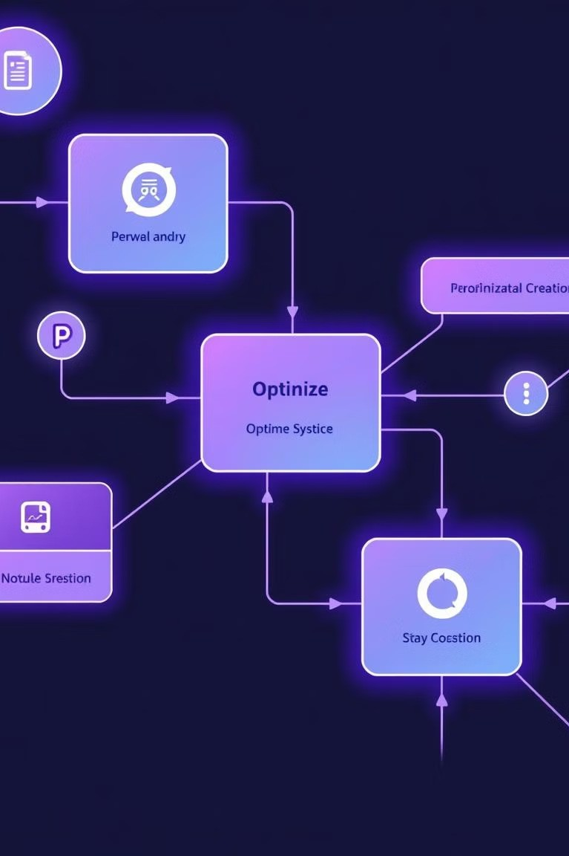
Techniques for Energy- Efficient Software
Reduce Network Traffic
Optimize data transfer protocols, use efficient compression techniques, and implement caching mechanisms.
Power Management
Enable power-saving modes for devices, utilize dynamic voltage scaling, and implement sleep states.
Efficient Data Storage
Use efficient database systems, implement data compression, and leverage cloud storage solutions.

Slide 9




Measuring and Monitoring Software's Carbon Footprint
Carbon Footprint Analysis
Track energy consumption and carbon emissions throughout the software development process.
Energy Efficiency Monitoring
Measure the energy consumption of software applications in production environments.
Performance Optimization
Identify bottlenecks and optimize software performance to reduce energy consumption.

Slide 10
Integrating Sustainability into the Software Development Lifecycle
Design Phase
Incorporate sustainability considerations into the initial design and architecture.
1
Development Phase
Develop software using efficient coding practices and tools.
2
Deployment Phase
Deploy software on energy-efficient infrastructure and optimize for resource utilization.
3
Maintenance Phase
Monitor and improve software performance, minimizing energy consumption and carbon emissions.
4

Slide 11
Group Members
1 .Sahil satani
2. Urvish magroliya
3. Bhuva kishan
4.

